Slide 1
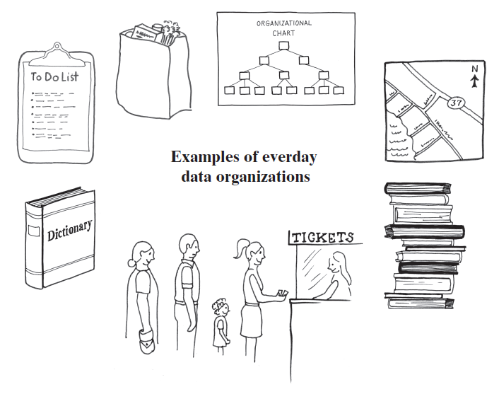
Chapter 3: Bag Implementation that Links Data
Manar Mohamed
mohamem@miamioh.edu

Slide 2
Leetcode
Set up an account
Start solving problems
Problems 237 and 83 are good starting problems

Slide 3
Array-based implementation of Bag
The next several slides are about our array-based implementation of Bag.

Slide 4
Consider the following code. Which string will be returned by the call to remove()? Bag bag = new Bag(5); bag.add("cat"); bag.add("dog"); bag.add("house"); String house = bag.remove();
cat
dog
house
null
None of the above

Slide 5
If the array representing our bag contains {"t", "o", "p", null, null}, what will it contain after calling bag.add("s")?
{"t", "o", "p", "s", null}
{"s", "t", "o", "p", null}
{"t", "o", "p", null, "s"}
none of these

Slide 6
If the array representing our bag contains {"a", "b", "c", "d", null}, what will it contain after calling bag.remove("b")?
{"a", "d", "c", null, null}
{"a", null, "c", "d", null}
{"a", "c", "d", null, null}
{"a", "d", "c", "d", null}
none of these

Slide 7
Our algorithm for remove(Object):
Find the object that matches. {"a", "b", "c", "d", null}
Replace it with the last object. {"a", "d", "c", "d", null}
Set the last reference to null (to clean up unneeded references) {"a", "d", "c", null, null}

Slide 8
If words contains {"a", "b", "a", null, null}, what will be the final value of count? int count = 0; for (int i=0; i<3; i++) { if (words[i] == "a") { count++; } }
0
1
2
3
none of the above

Slide 9
If words contains {"a", "b", "a", null, null}, what will be the final value of count? int count = 0; for (int i=0; i<3; i++) { if (words[i].equals("a")) { count++; } }
0
1
2
3
none of the above

Slide 10
Compare objects for equality using .equals() rather than ==
== checks if references are equal
equals() checks if the objects are equal

Slide 11
If the array representing our bag contains {"t", "o", "p", null, null}, what should bag.toArray() return?
{"t", "o", "p", null, null}
{"t", "o", "p"}
none of these

Slide 12
Should only want to see the items that were put in the bag.
The size of the returned array should be the number of items in the bag.
If there are no items in the bag, return an array of size 0.

Slide 13
One way to copy an array:
Create an array of the desired size
Copy the items one by one from the old array to the new array

Slide 14
Another way to copy an array:
Arrays.copyOf( oldArray, newSize)
Returns a new array, either padded (with extra nulls), or truncated
It is equally inefficient because all it does is makes a new array and copies the items one by one.

Slide 15
What if you wanted to have a bag that can grow to any size?
You could use a resizable array implementation.
How? If the array is full and we want to add another element...
Create a new array that is bigger (twice the size is a good choice)
Copy the data from the old array to the new array
Point the instance variable to the new, bigger array
Arrays.copyOf() is a useful method that accomplishes the same thing.
See chapter 2.

Slide 16
Linked Data: An alternative to resizable arrays
Resizable arrays (think: ArrayList) have some good and bad qualities:
GOOD: index based so it is easy to access the item you need
BAD: inserting and deleting items is "expensive" because it requires shifting elements up or down, Resizing requires overhead of time
Linked data are an alternative to resizable arrays. They also have good and bad qualities:
GOOD: inserting and deleting items is much more efficient...no shifting needed
BAD: no indexes, so accessing an element by position is "expensive"
See http://stackoverflow.com/questions/322715/when-to-use-linkedlist-over-arraylist

Slide 17
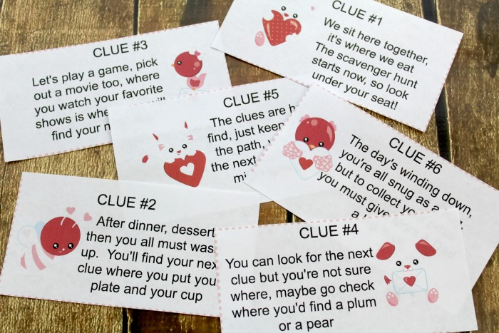
What is Linked Data?
Analogy: A scavenger hunt with clues to the next location

Slide 18
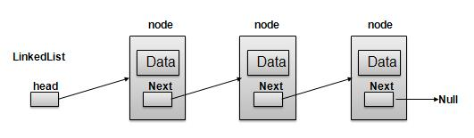
Linked data relies on the idea of having "nodes"
A node contains two key pieces of information:
The data (for example, a String, an integer, etc.)
A "pointer" to the next node (in Java… a reference...null if there is no next node)
So, a linked data structure (linked list, linked bag) is just a bunch of nodes.

Slide 19
In an array implementation of an int Bag, which of these operations uses a loop?
remove()
remove(int i)
add(int i)
getCurrentSize()

Slide 20
In a chain of linked nodes, which of these uses a loop?
adding to the head
adding to the tail
removing from the head
removing from the tail

Slide 21
In a linked node implementation of an int Bag, what should remove() return?
The head element because that's what the user will expect
The head because it is more efficient
The tail element because that's what the user will expect
The tail because it is more efficient

Slide 22
Which will be more efficient?
Removing the first item of an array?
Removing the first item of a chain of linked nodes?

Slide 23
Implementing Bag with linked nodes
Recall the key features of bags:
duplicates OK
order does not matter
need to be able to add, remove, count, find, and so on
Originally, we implemented with an array
adding new items: added to the end of the array
removing arbitrary items: removed from the end of the array
This week we will implement with linked nodes
adding new items: add to the beginning (head) of the chain
removing arbitrary items: remove from the beginning (head) of the chain

Slide 24
Implementing Bag with linked nodes:
We could use two separate classes:
Node
LinkedBag
Or, we could make Node an inner class of LinkedBag

Slide 25
Implementing Bag using linked nodes:
Instance variables:
The head of the nodes
The number of nodes
Same methods as before:
add, remove (2 versions), getFrequency(), contains, clear, isEmpty, etc.

Slide 26
Things to watch for:
Special cases:
null case
how to remove a particular node

Slide 27
END

